Slide 1
Loan Management System
Lathika GS

Slide 2

Problem Statement
Loan processing is often manual or semi-automated, causing delays and inefficiencies
Difficulty in tracking loan applications, approvals, and current status
Limited visibility into EMI schedules, repayments, and outstanding balances
Lack of centralized reporting and audit mechanisms
Security risks in handling sensitive customer financial data

Slide 3

Proposed Solution
Digitize the complete loan lifecycle from application to closure
Allow customers to apply for loans online and track their status
Enable loan officers to review, approve, or reject applications
Automatically generate EMI schedules and repayment tracking
Provide role-based access using JWT authentication
Offer dashboards and financial reports for better decision-making

Slide 4
Project Overview
The Loan Management System is a secure full-stack web application developed using ASP.NET Core Web API and Angular.
Backend developed using ASP.NET Core Web API (.NET 9) with Entity Framework Core and LINQ for business logic.
SQL Server used for secure and reliable data storage.
JWT-based authentication and role-based authorization implemented for application security.
Frontend built using Angular (21.0.4) with TypeScript and Angular Material / Bootstrap.
RESTful APIs documented using Swagger/OpenAPI and integrated with Angular via HTTPClient & Interceptors.

Slide 5
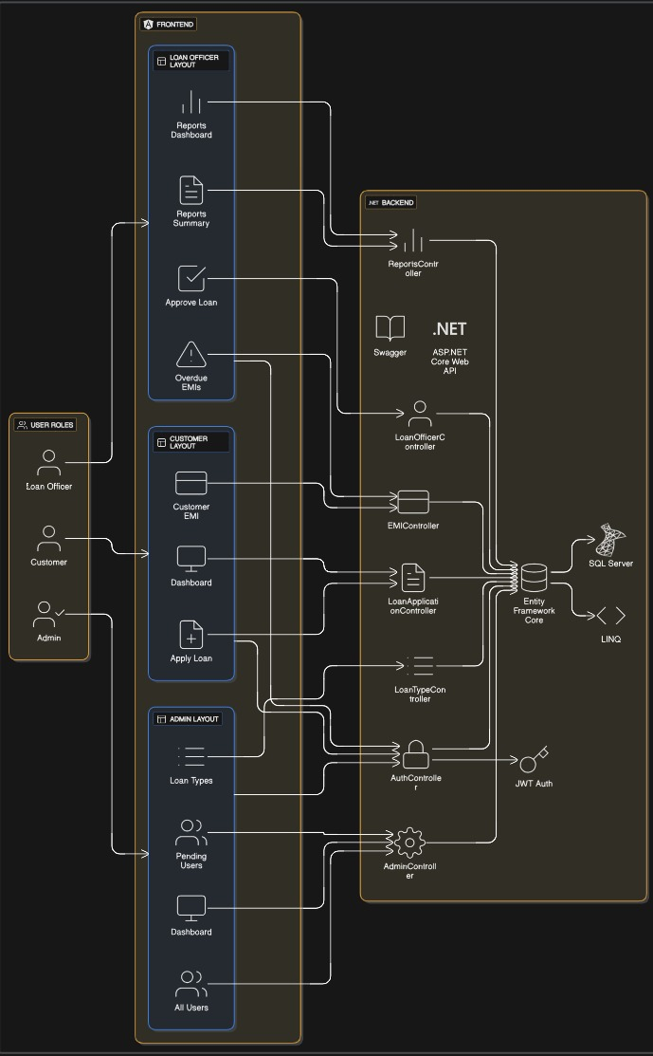
Architecture Diagram

Slide 6
Key Features
Admin Features
Manage loan types and interest rules
View and manage all users and pending users
Admin dashboard for system monitoring
Backend & Processing
RESTful APIs using ASP.NET Core Web API
Controllers for Auth, Loan Applications, EMIs, Reports, and Admin
Business logic implemented using LINQ
Data & Security
Secure data storage using SQL Server
ORM handled via Entity Framework Core
API documentation with Swagger
Role-Based Access Control
Separate interfaces for Admin, Loan Officer, and Customer
Secure access using JWT Authentication
Customer Features
Online loan application submission
View loan status and dashboard
Track EMI schedules and repayments
Loan Officer Features
Review and approve/reject loan applications
View overdue EMIs
Access reports dashboard and summaries

Slide 7
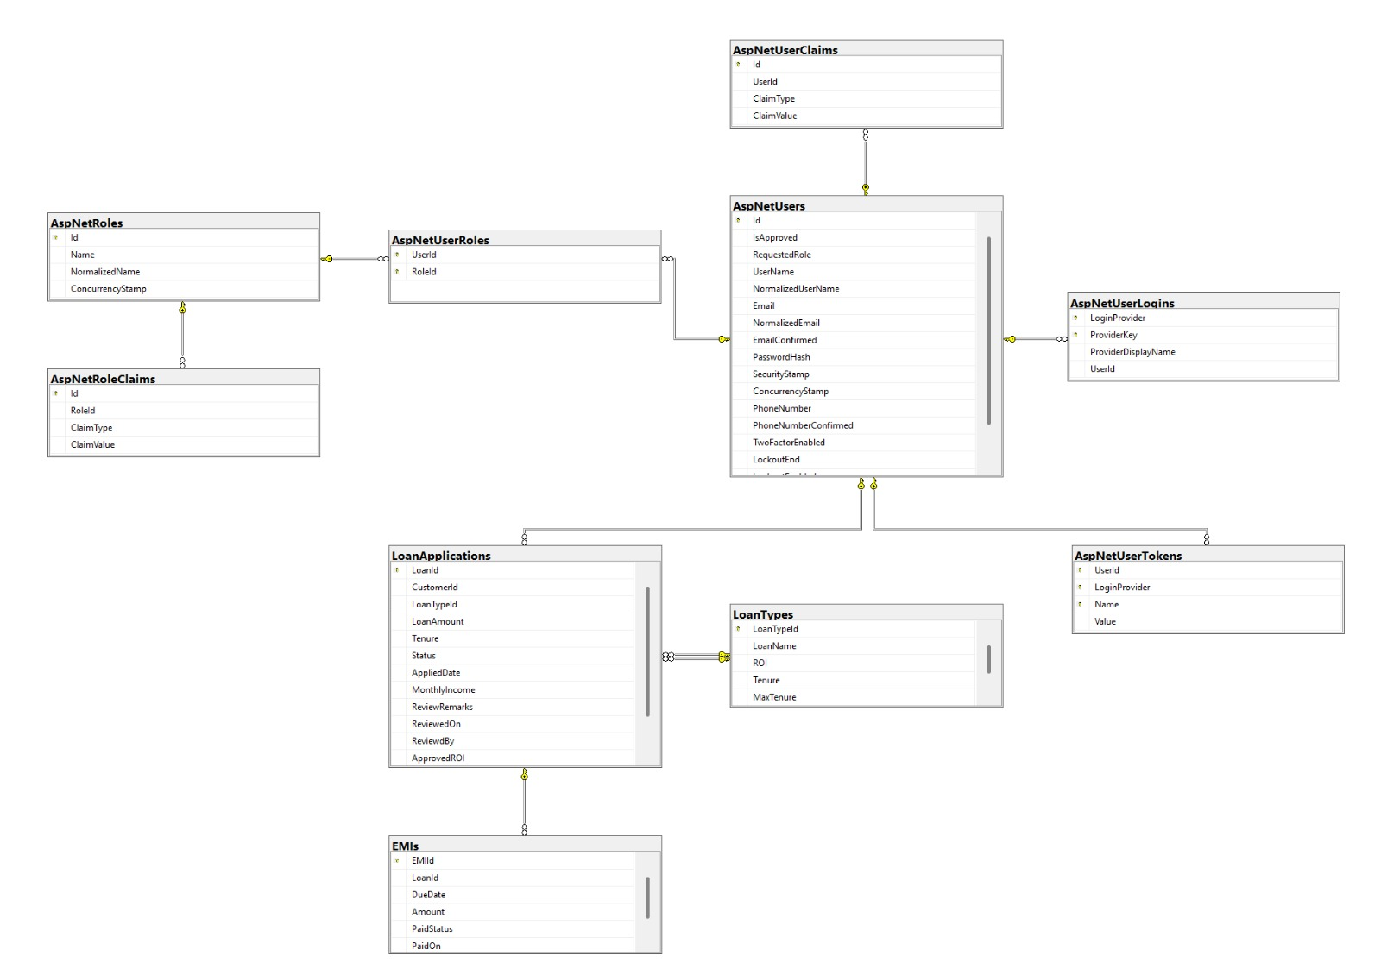
Database Diagram

Slide 8
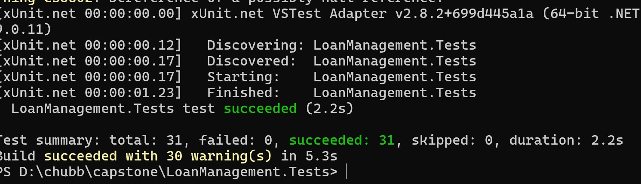
Testing
Unit testing using xUnit for testing the functionality of Backend
API testing with Postman to check all CRUD functionality
Authentication and authorization tests with JWT Bearer Token

Slide 9
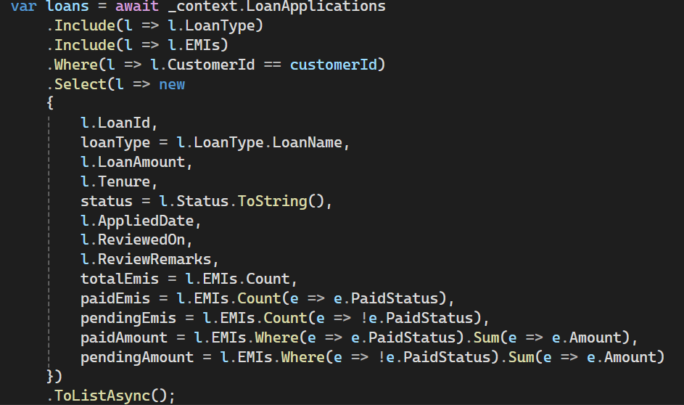
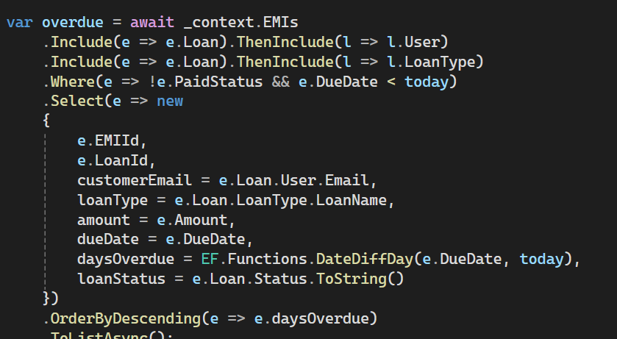
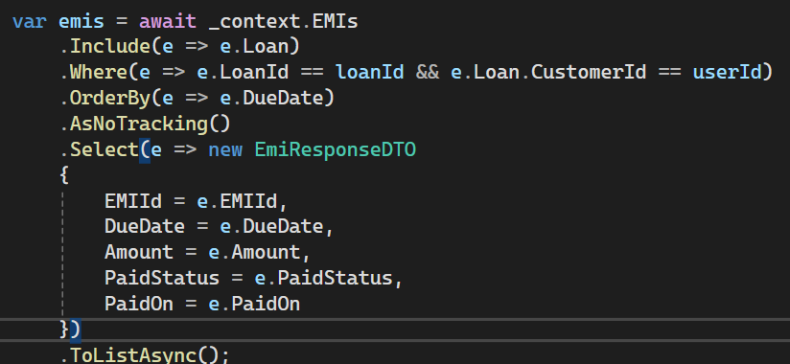
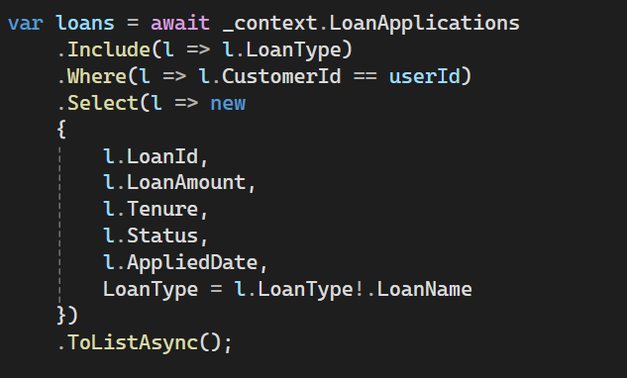
LINQ Usage
Used LINQ with entity framework core to query database entities
Applied where, select, include, and aggregation methods
Ensured optimized queries by projecting only required fields

Slide 10

Results and Achievement
Successfully developed a secure full-stack Loan Management System using ASP.NET Core and Angular
Implemented JWT-based authentication and role-based authorization for Admin, Loan Officer, and Customer
Automated the complete loan lifecycle from application to approval, EMI generation, and closure
Enabled real-time loan tracking, EMI schedules, and overdue monitoring
Achieved clean data handling using Entity Framework Core and LINQ queries
Built interactive dashboards and reports for better decision-making
Ensured scalable, maintainable, and secure architecture following industry best practices

Slide 11
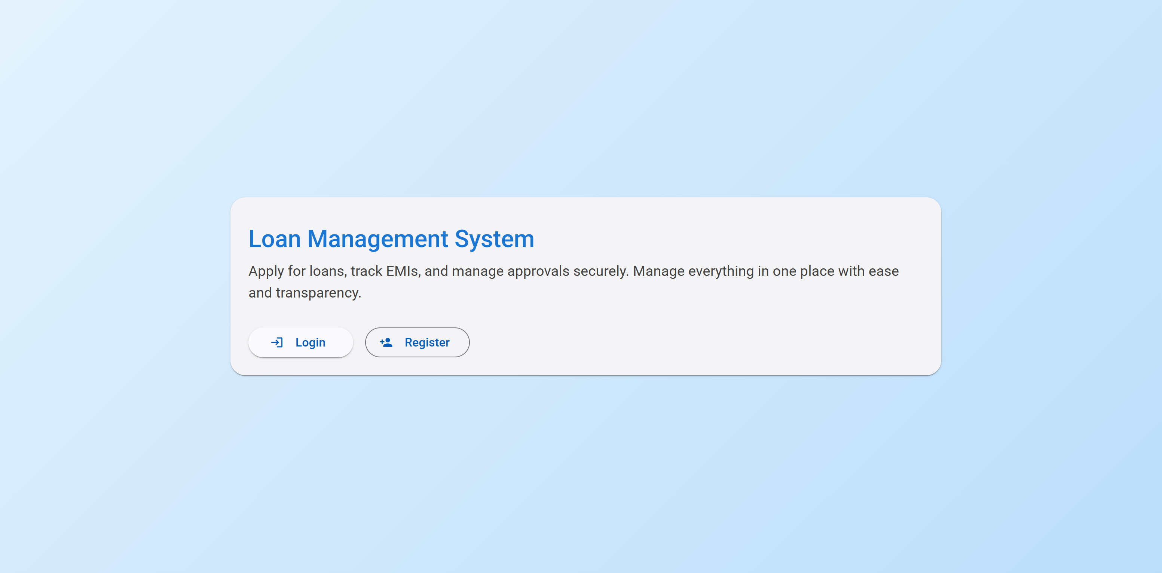
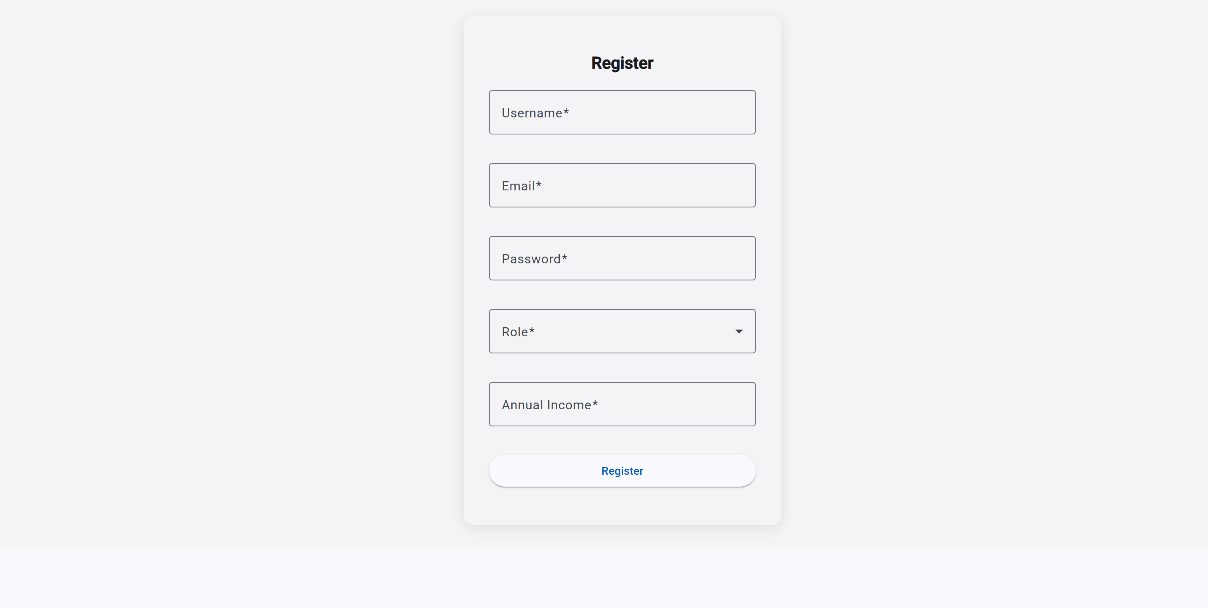
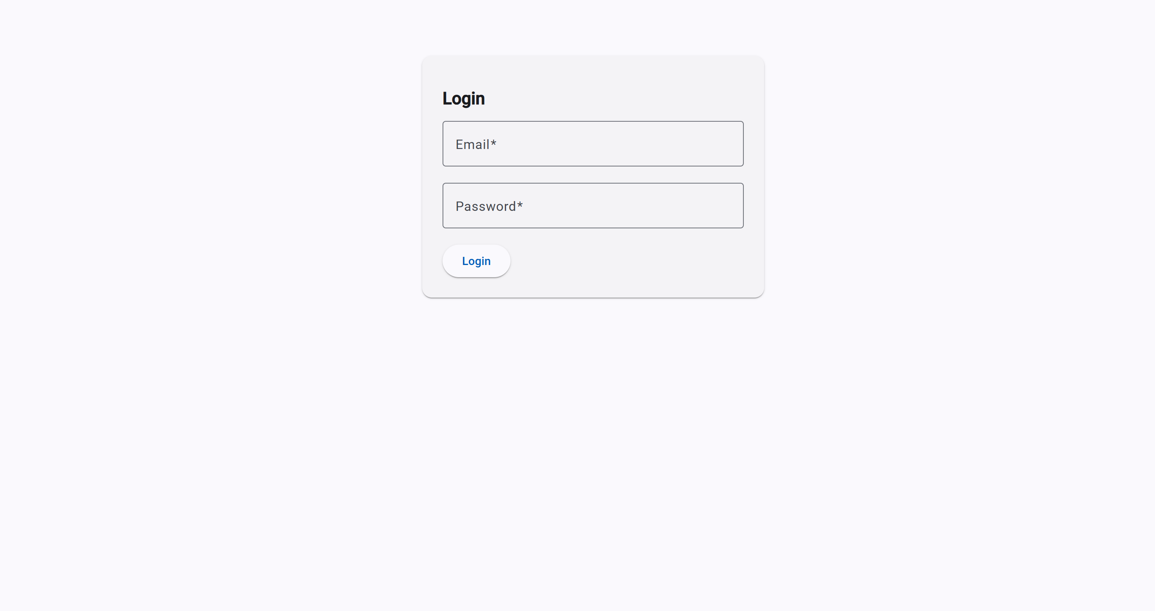

Slide 12
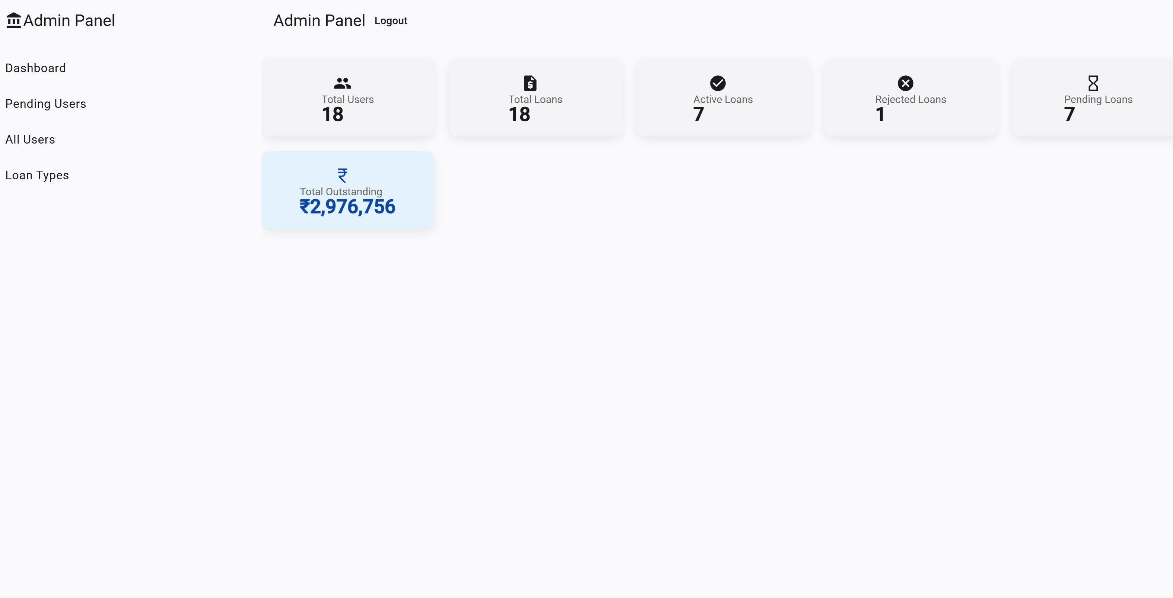
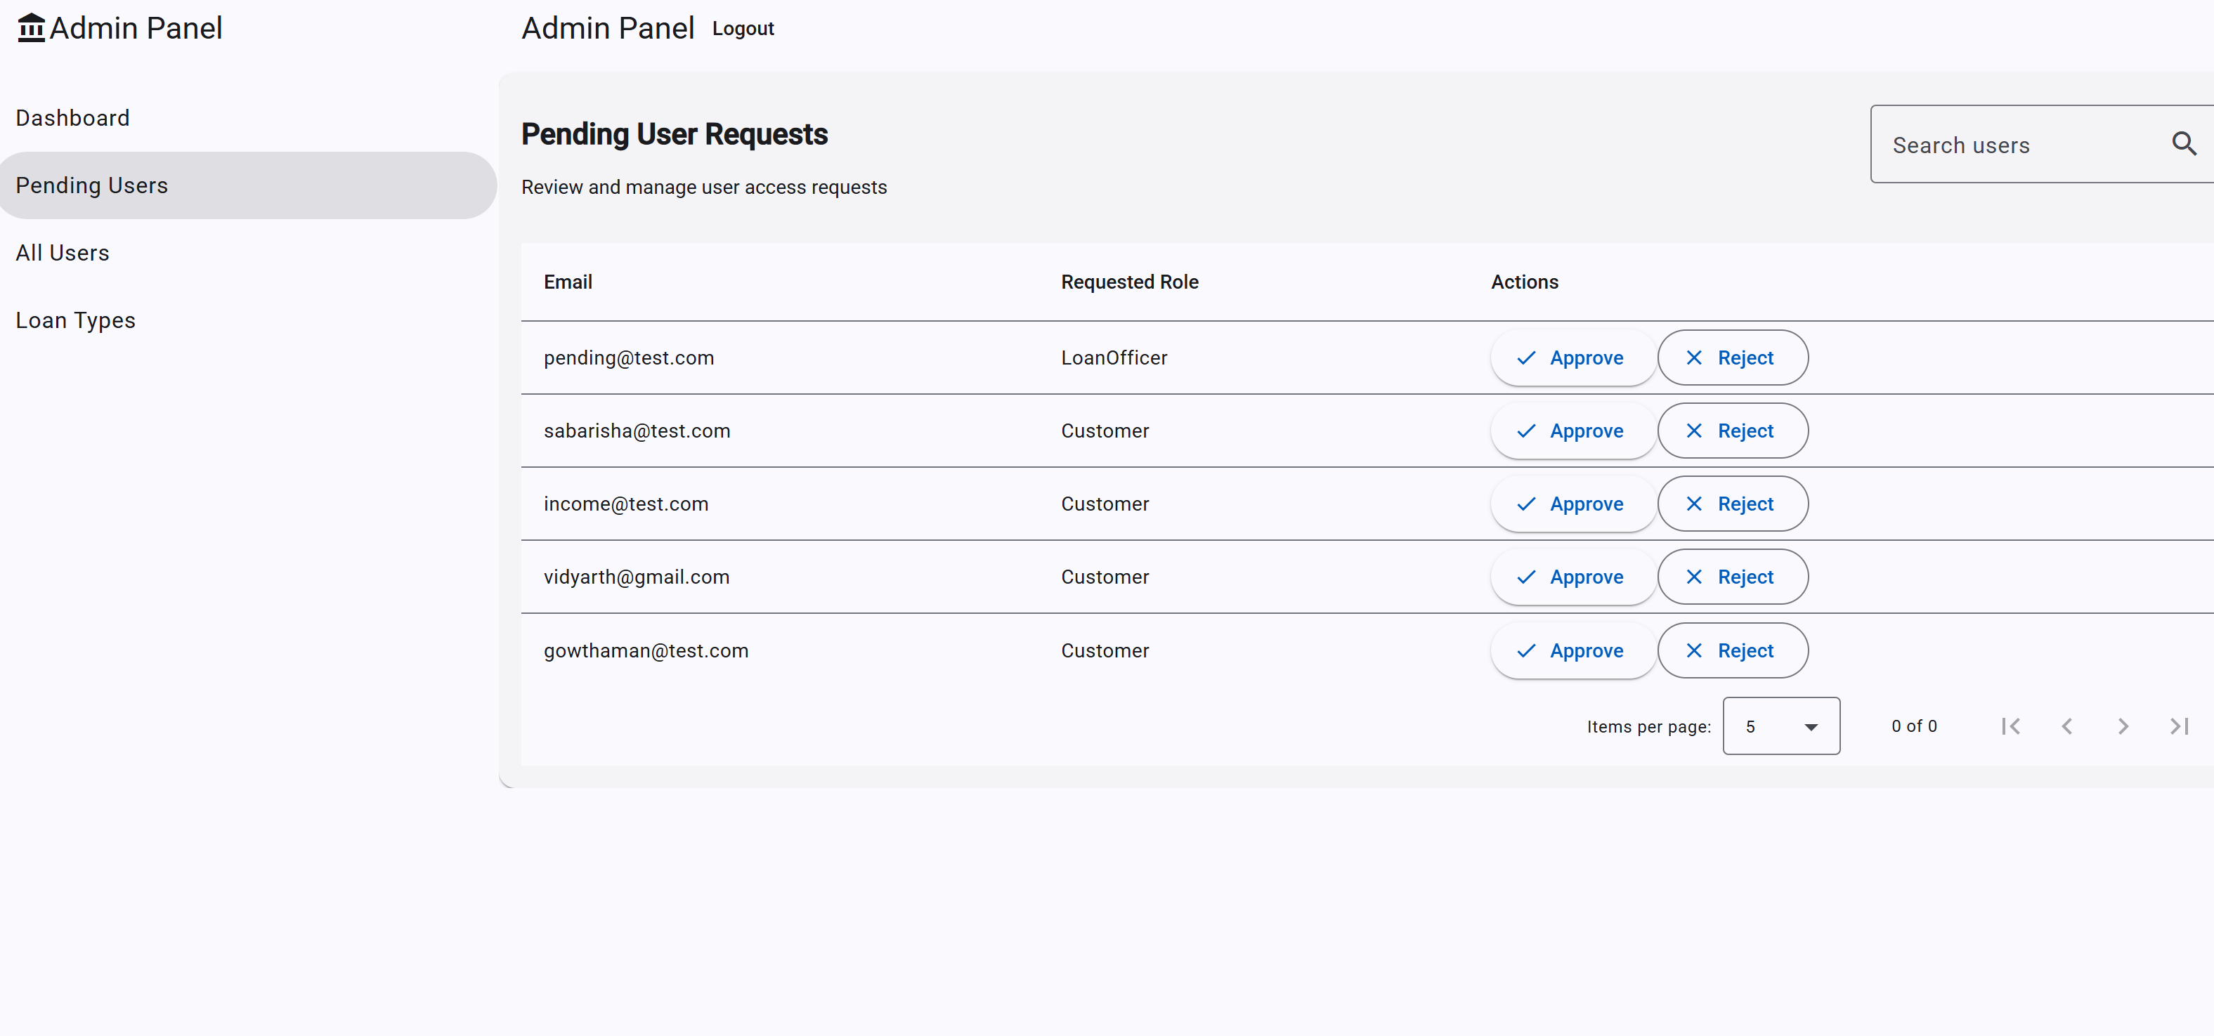
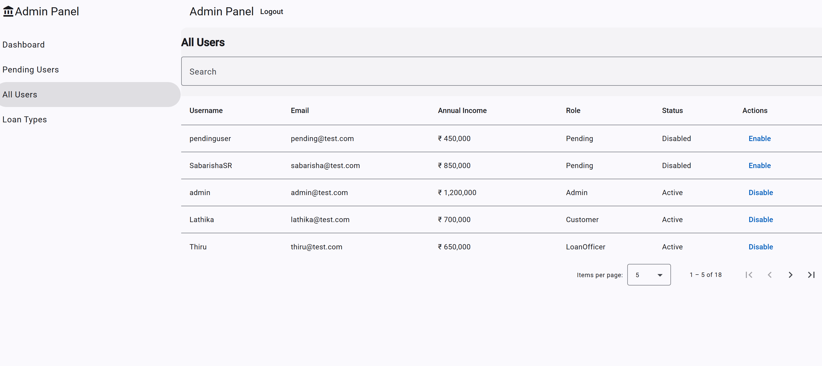
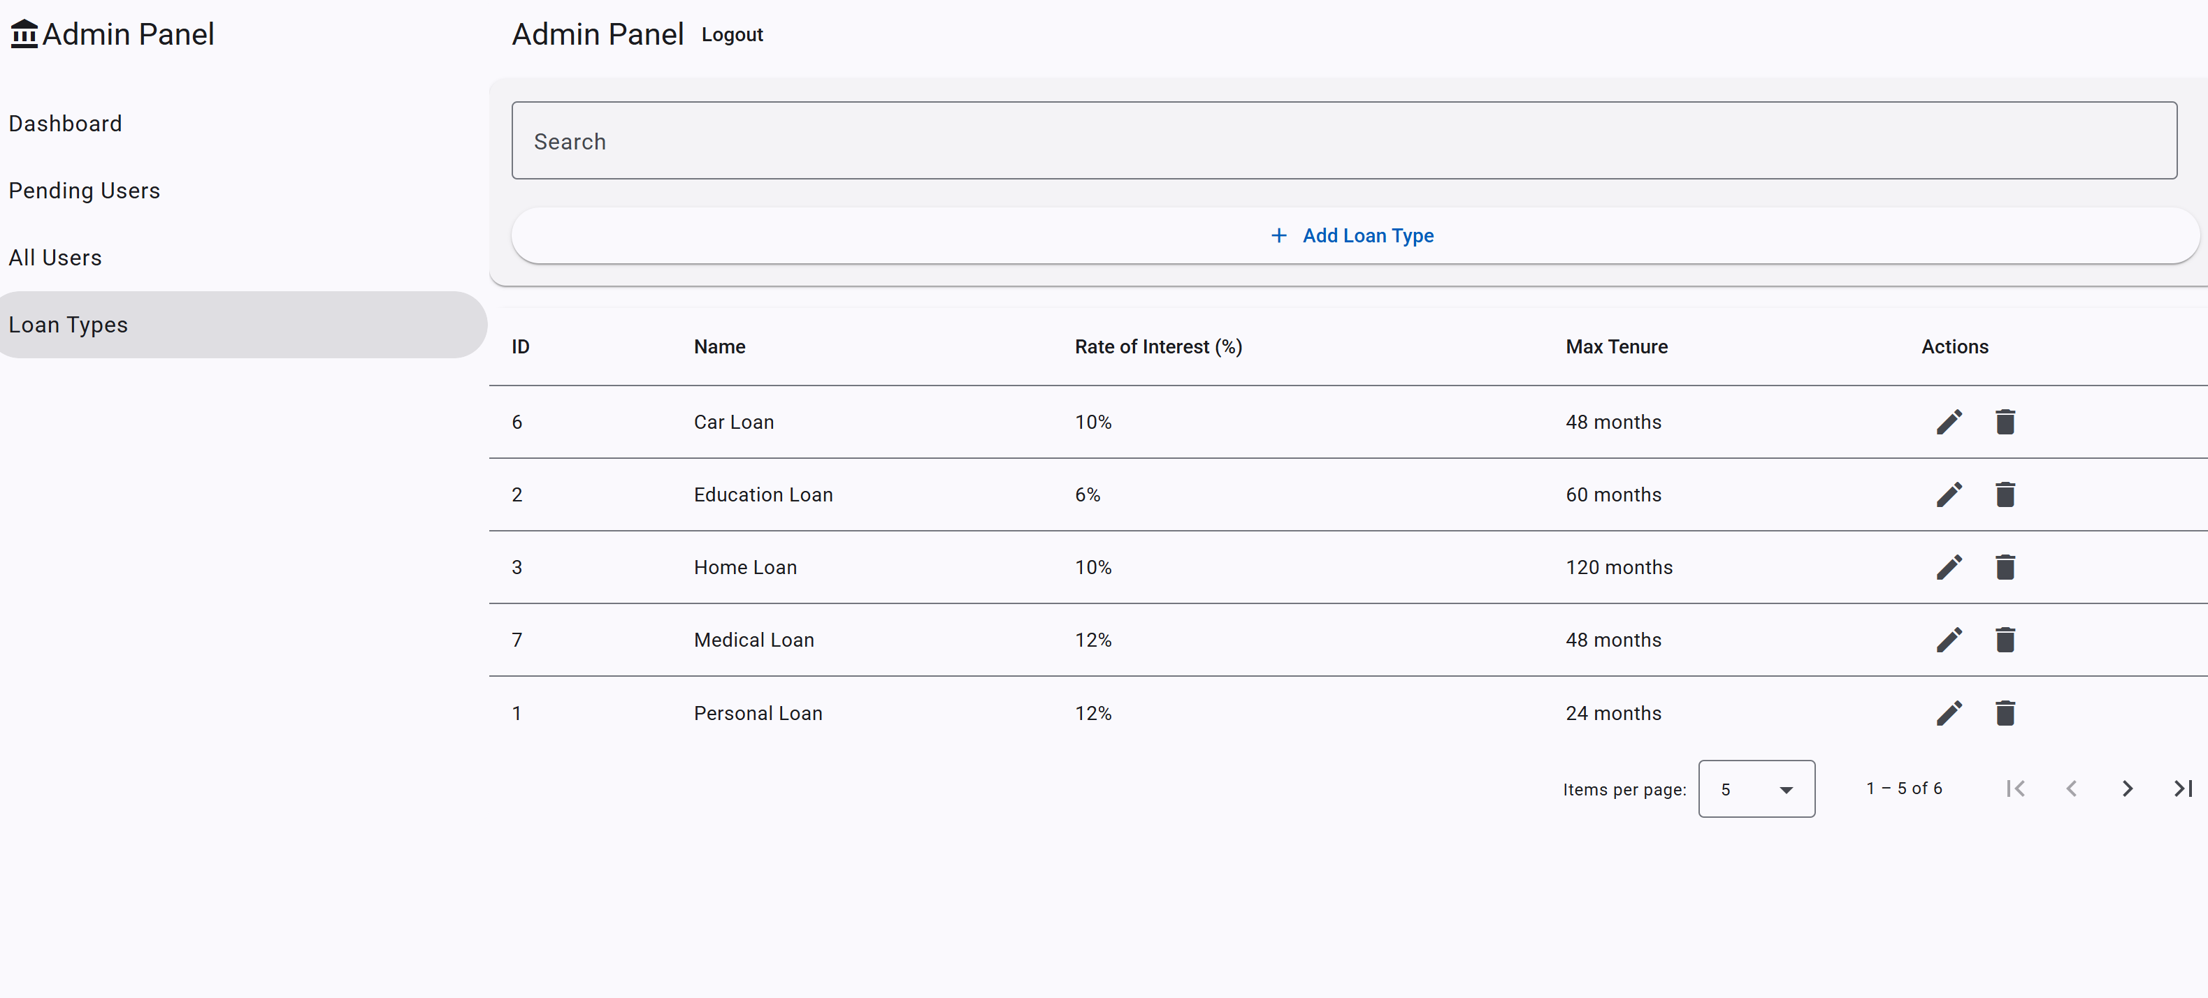

Slide 13
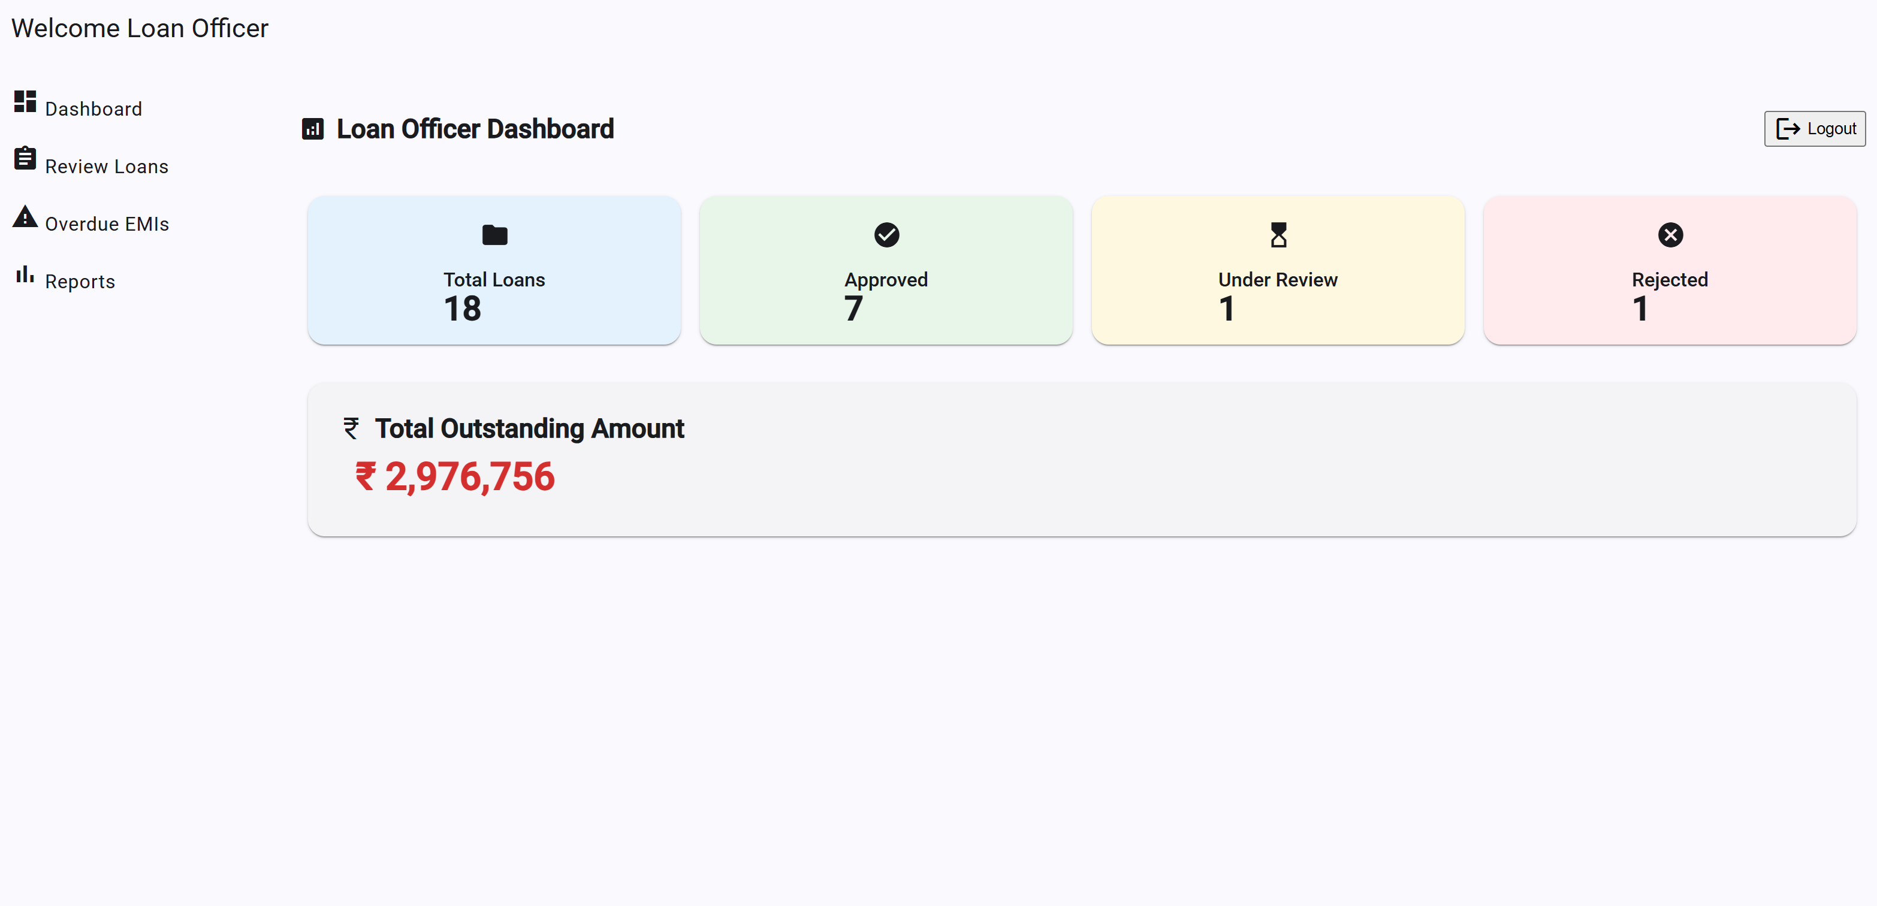
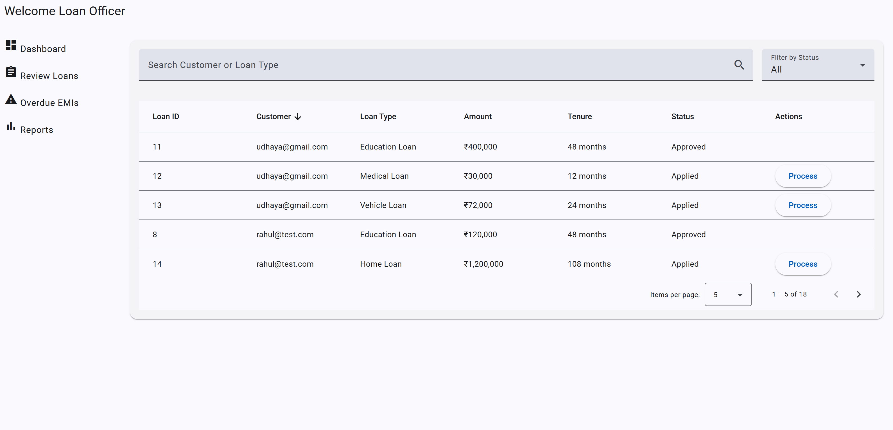
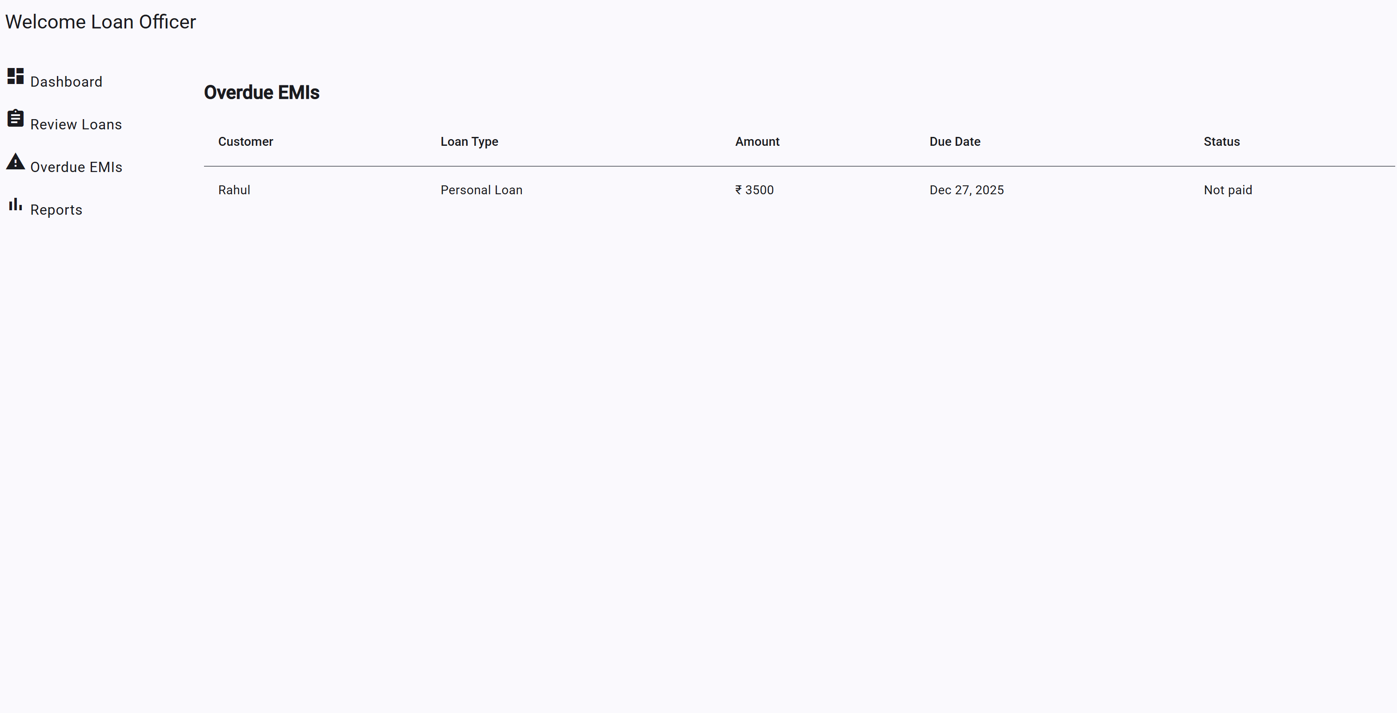
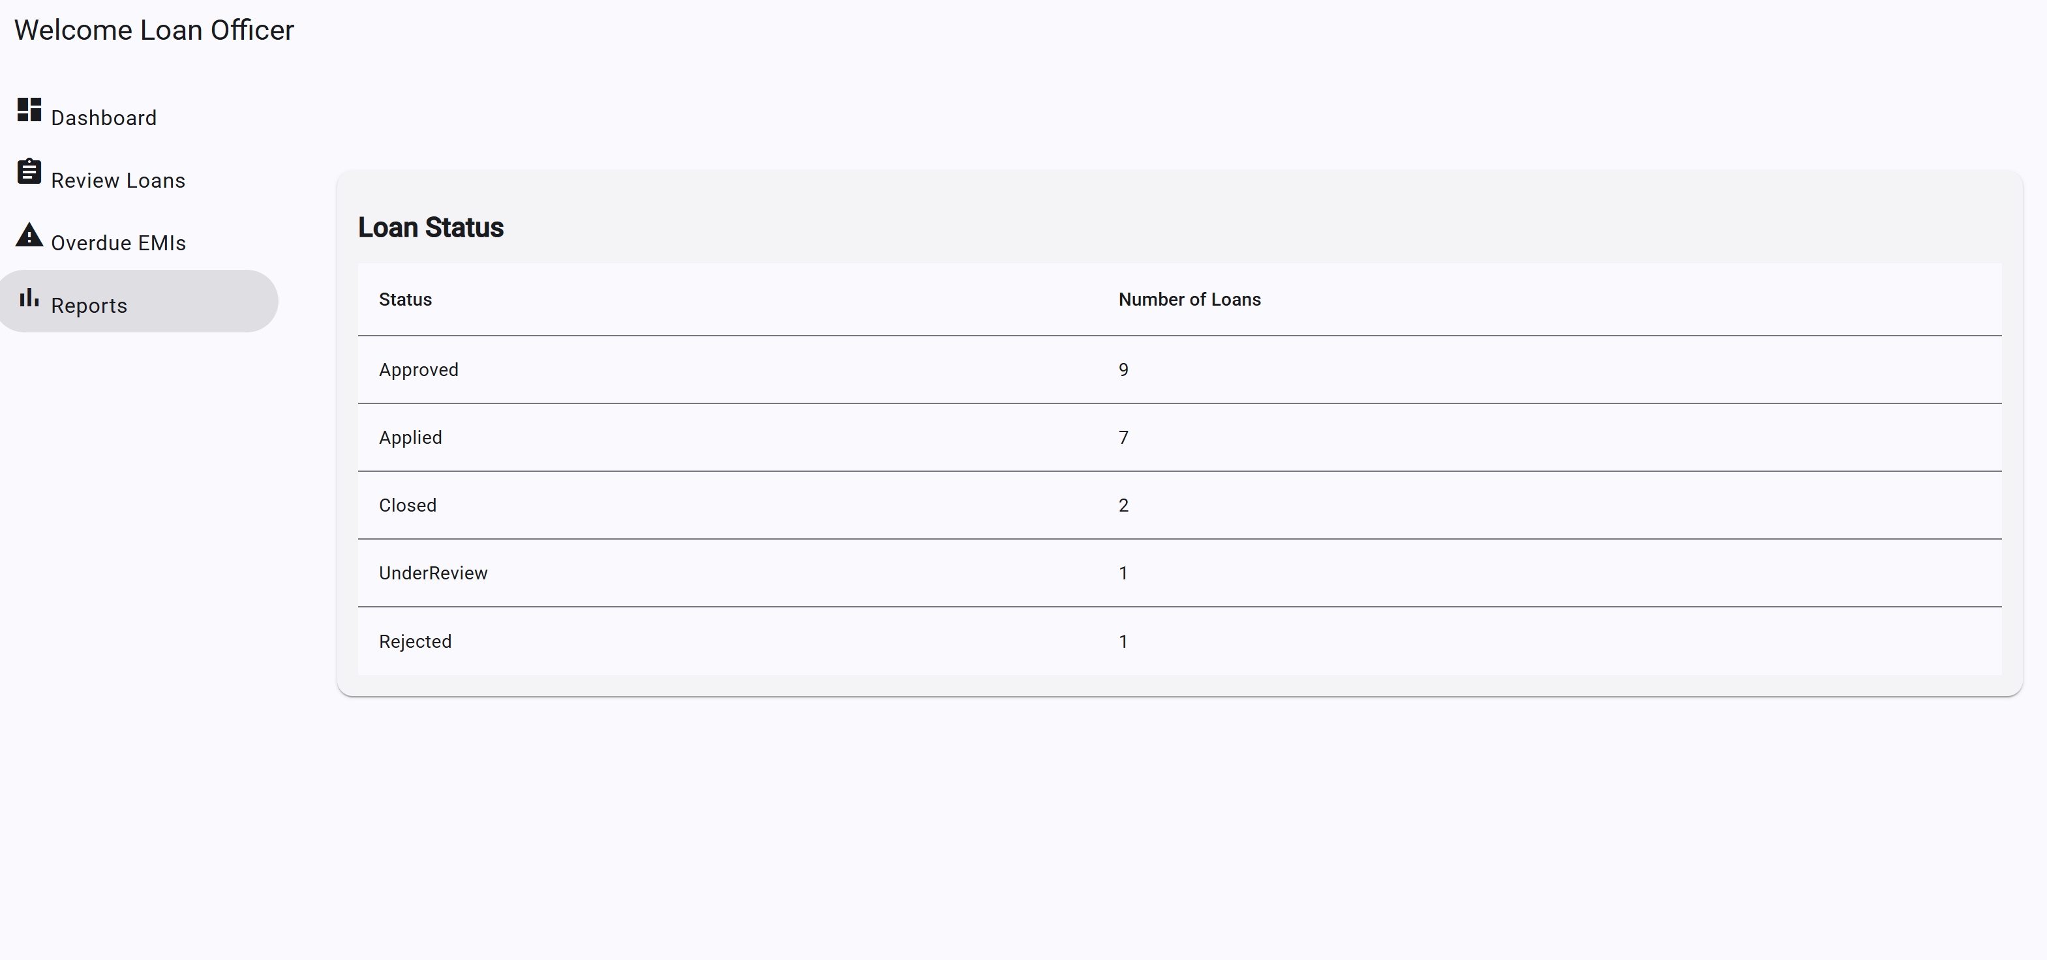

Slide 14
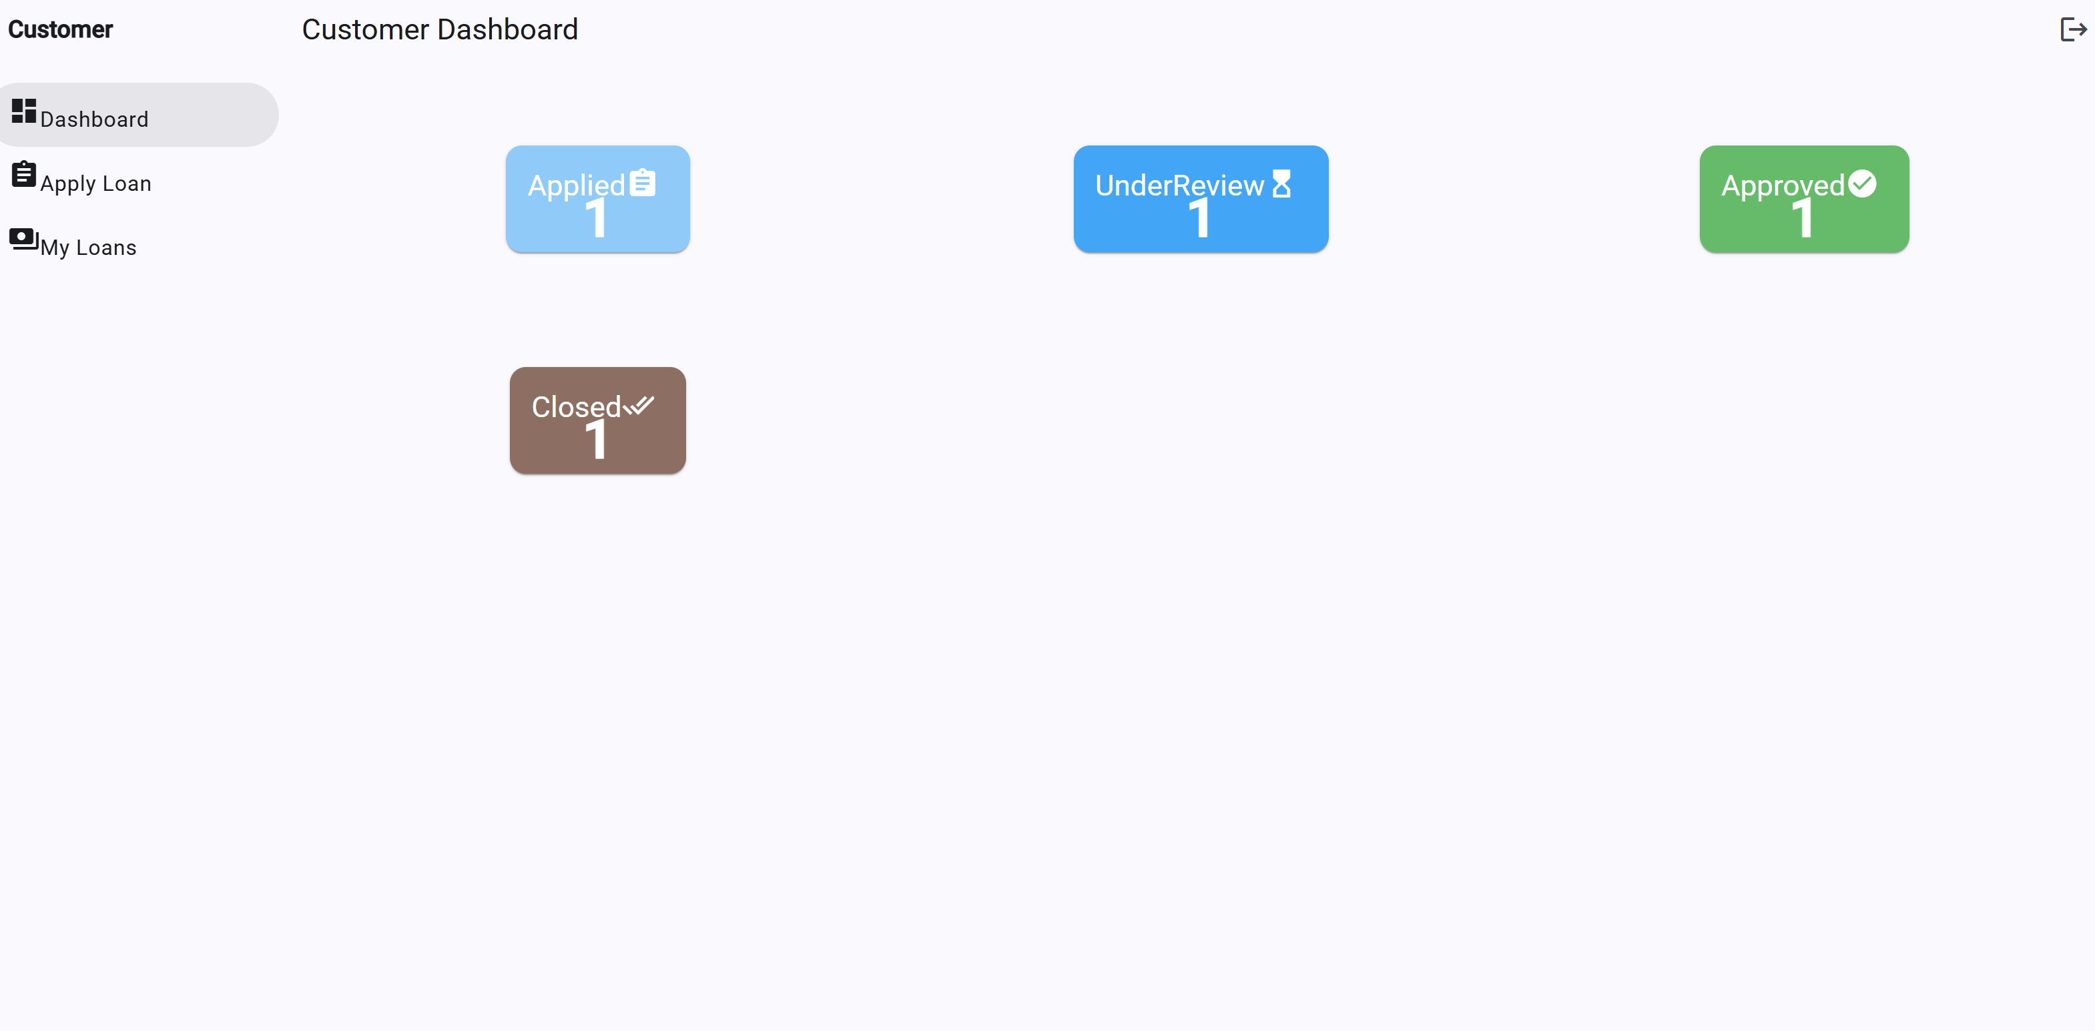
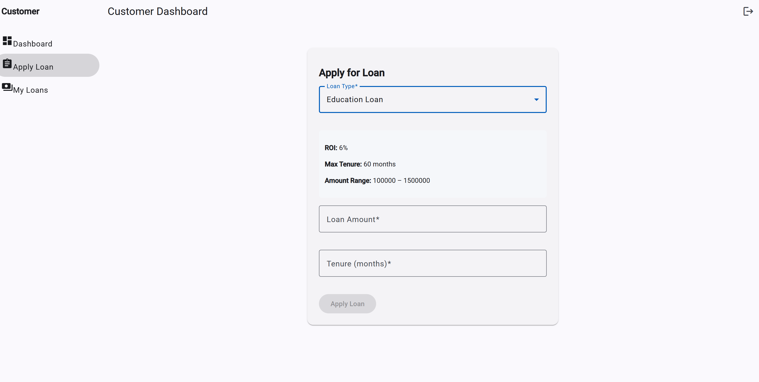
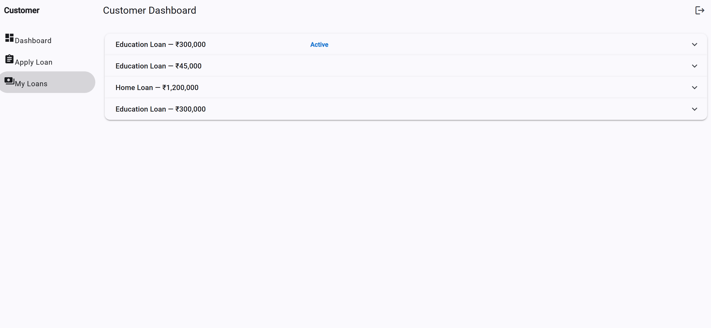
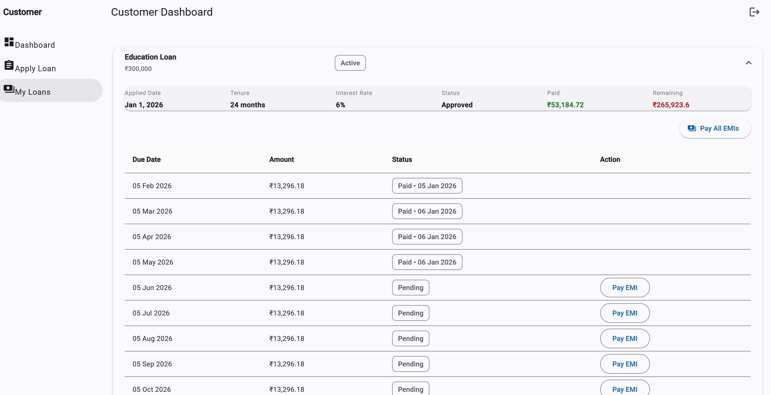

Slide 15
Thank you
Lathika gs (vit Chennai)
lathikasabari4@gmail.com

